Slide 1
Azure Synapse Analytics
Azure Synapse Analytics is all in one combo of ADLS, ADF, Databricks, Dedicated SQL Database, Serverless SQL(Only SQL operation no Storage).Just rather than using many resources, we use synapse
It is user friendly and easy but bit costly.

Slide 2
Important
It includes ADF, Databricks, ADLSv2, Serverless SQL, Dedicated SQL Server,
The Storages and SQL database are already linked to ADF and Databricks.
It is bit costly as all services are already available.
Serverless SQL pool is used to perform query without creating SQL database means without money ( It is automatically created)
Dedicated SQL pool is used for storage of target table.

Slide 3
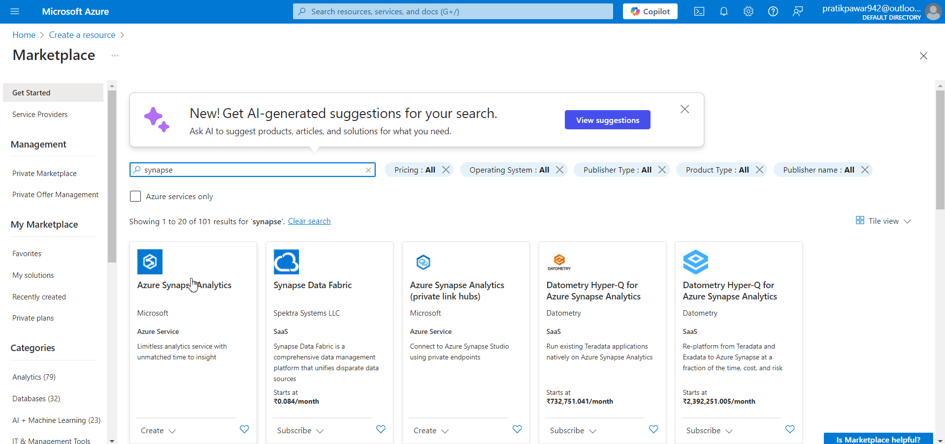
Go to Marketplace > Azure Synapse Analytics

Slide 4
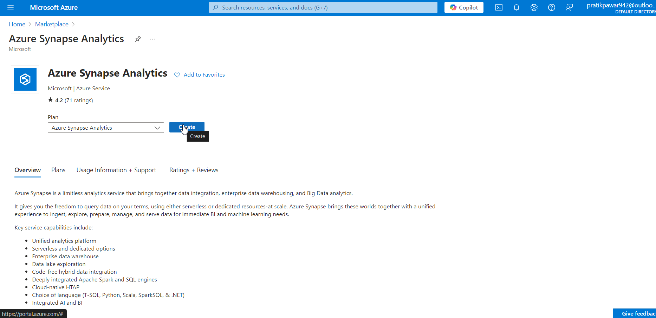
Create

Slide 5
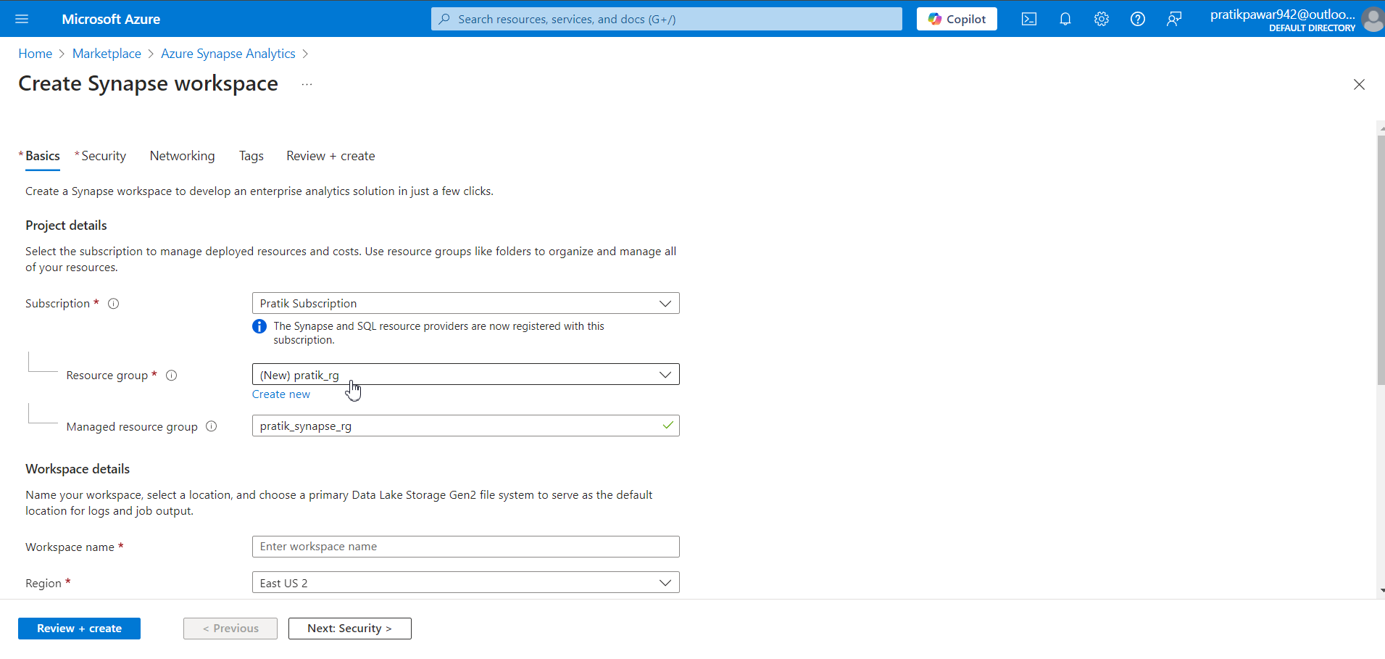
Create main resource group

Slide 6
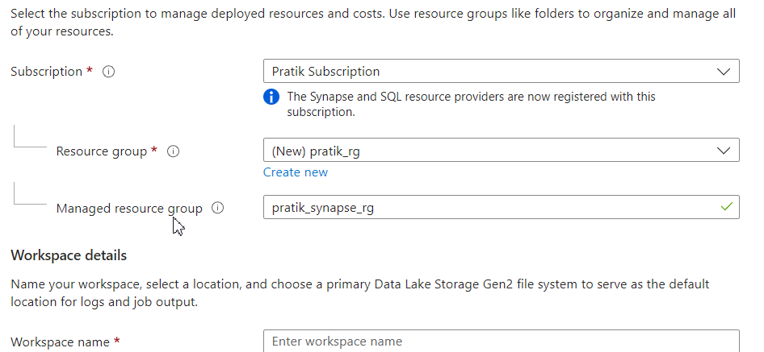
Now create managed resource group ( It is like if we are doing multiple projects in one synapse then their info are separated through Managed resource group)

Slide 7
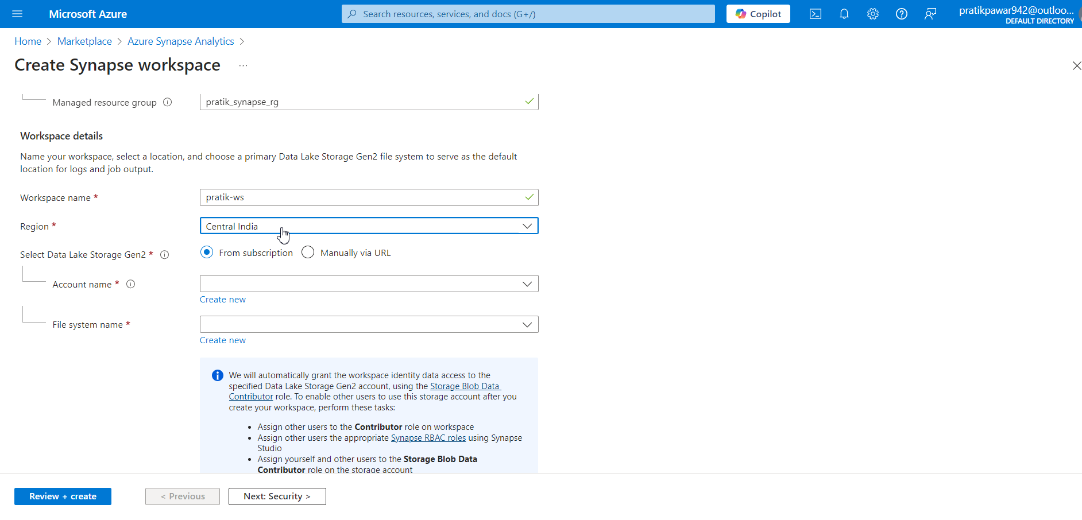
Type work space name and region according to requirement

Slide 8
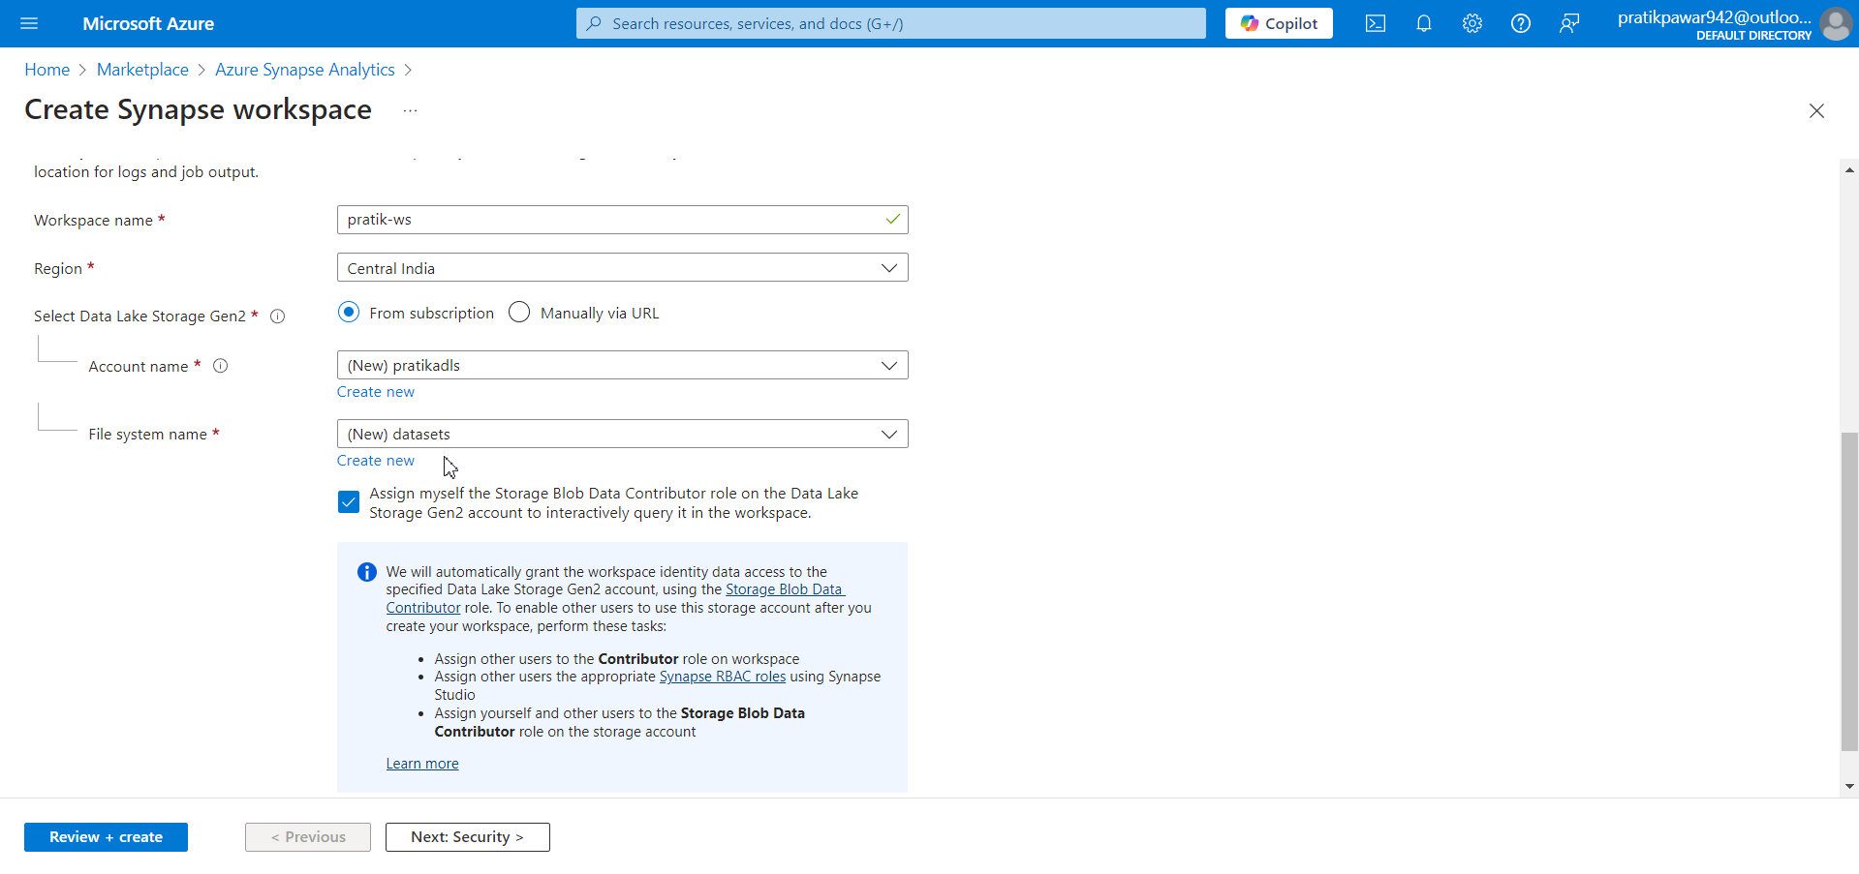
Now give the Acc name for ADLS in Synapse. File system name means container in ADLS

Slide 9
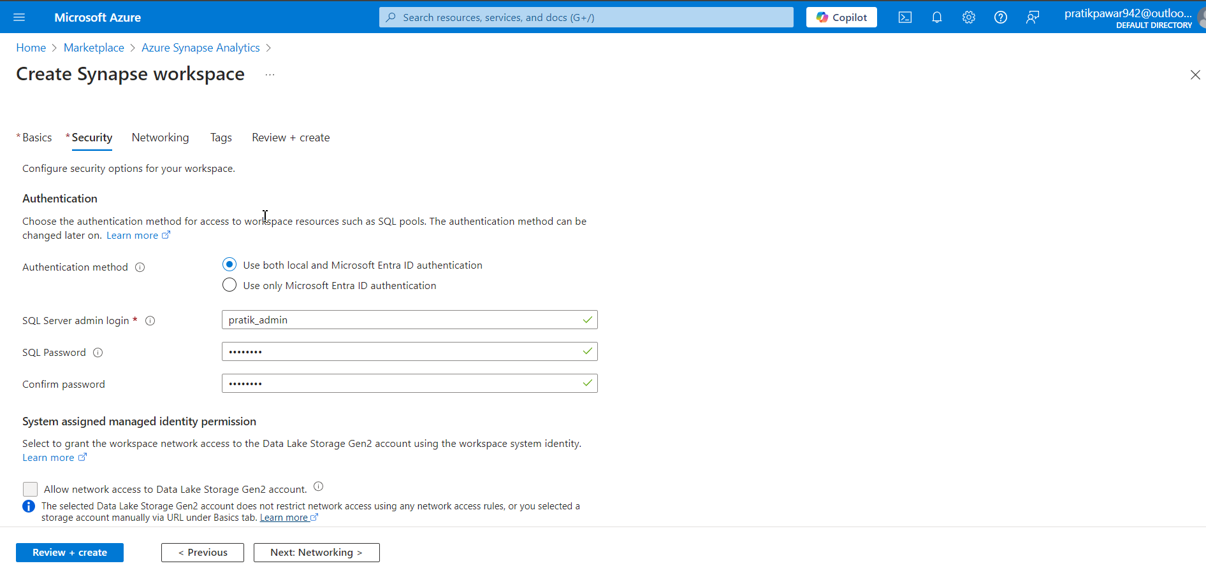
Now in security, fill the SQL admin and password. This SQL server info is about Serverless SQL not Dedicated SQL( Dedicated SQL is created inside Synapse

Slide 10
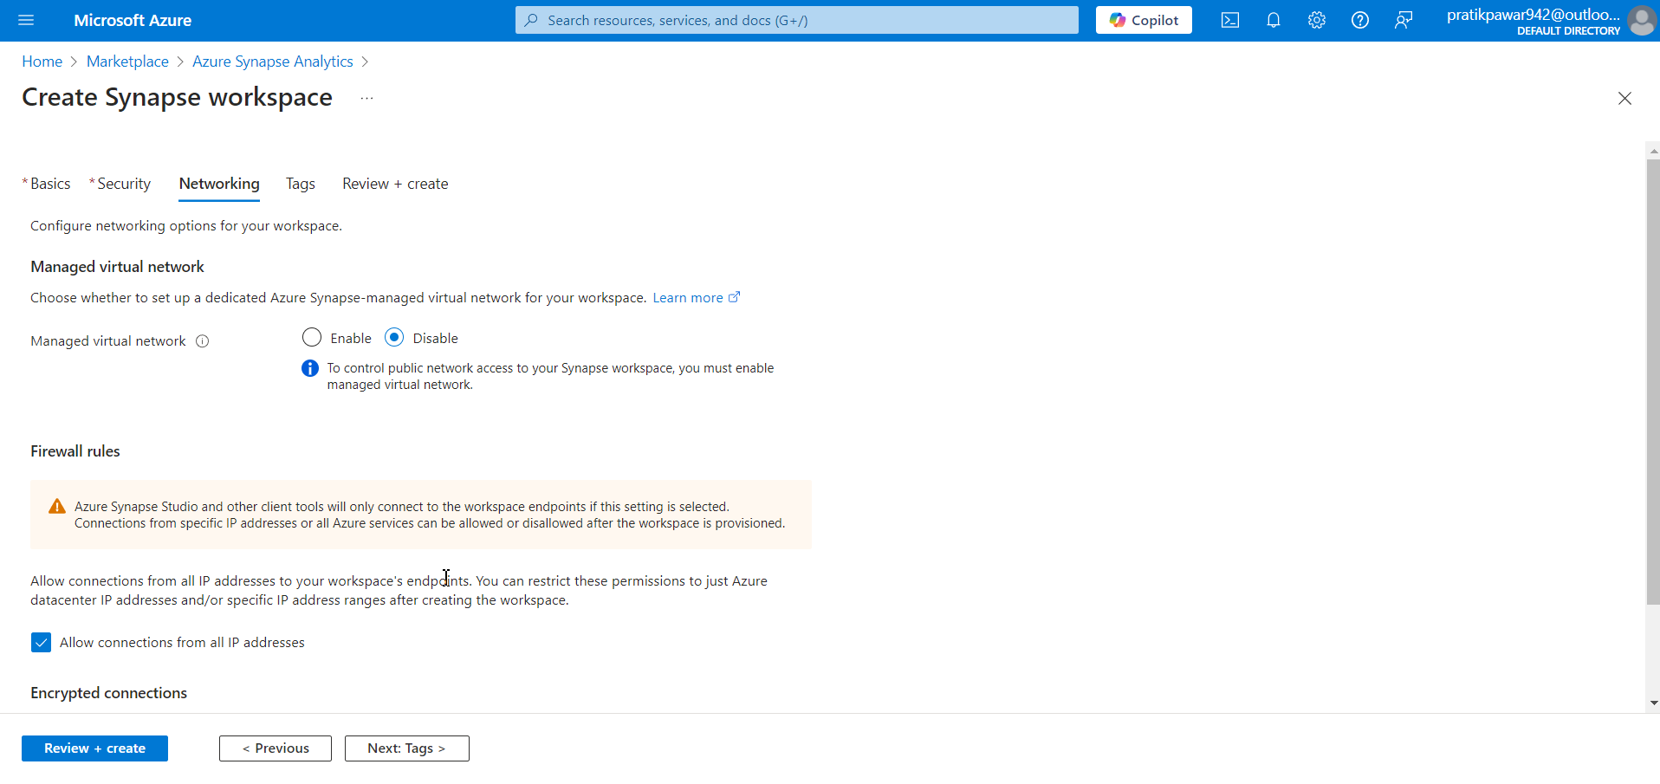
Networking

Slide 11
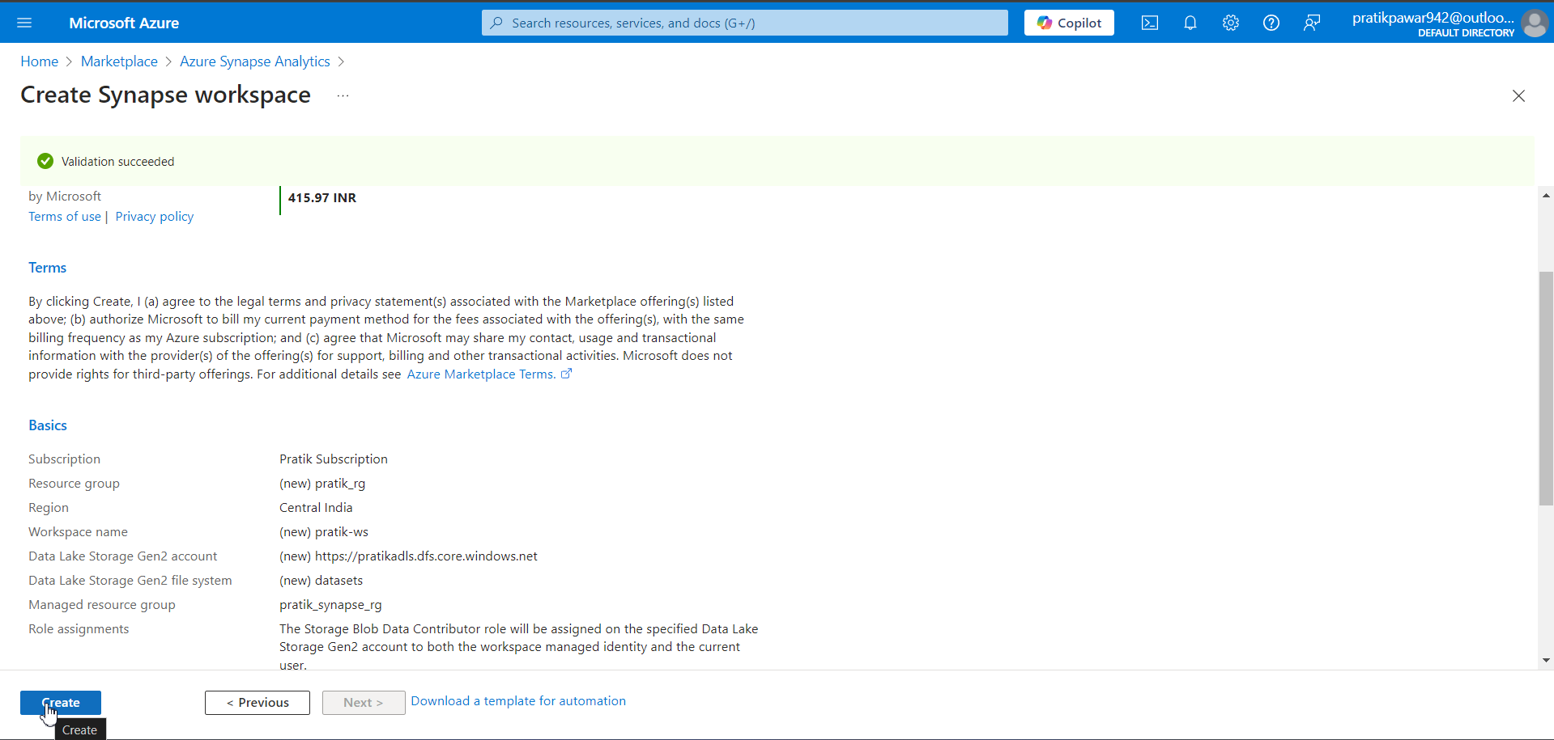
Create

Slide 12
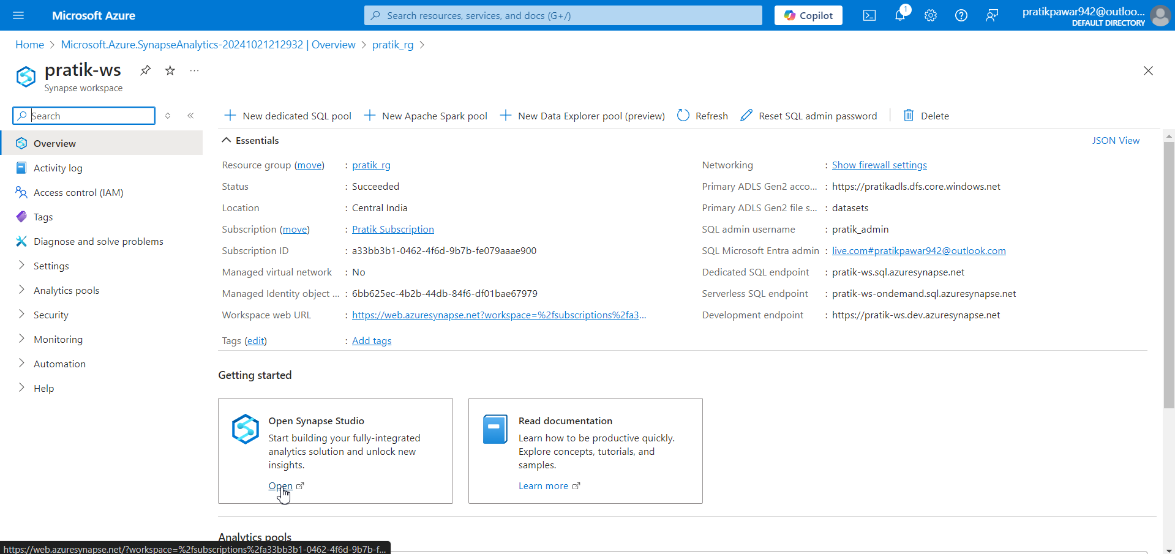
Open

Slide 13
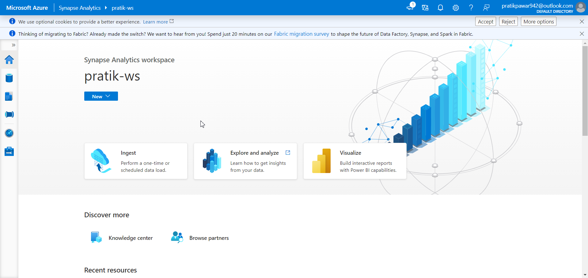
Azure Synapse Analytics WS

